Slide 1
FutureGenius LMS
Project Documentation
Group ID: S25PROJECT706CE
Student ID: BC200409484
Supervisor Name: Abdullah Qamar
Project Title: FutureGenius LMS

Slide 2
Introduction
The Kidicode LMS is a web-based learning management system designed for a company offering STEM and AI coding courses for kids in Pakistan.
It provides an interactive and engaging platform for students to learn through online and in-person sessions. The system supports user roles like admin, instructor, student, and parent for efficient management. It includes features like course management, quizzes, gamification, and progress tracking. The goal is to create a secure, user-friendly, and scalable solution to enhance digital learning for children.

Slide 3
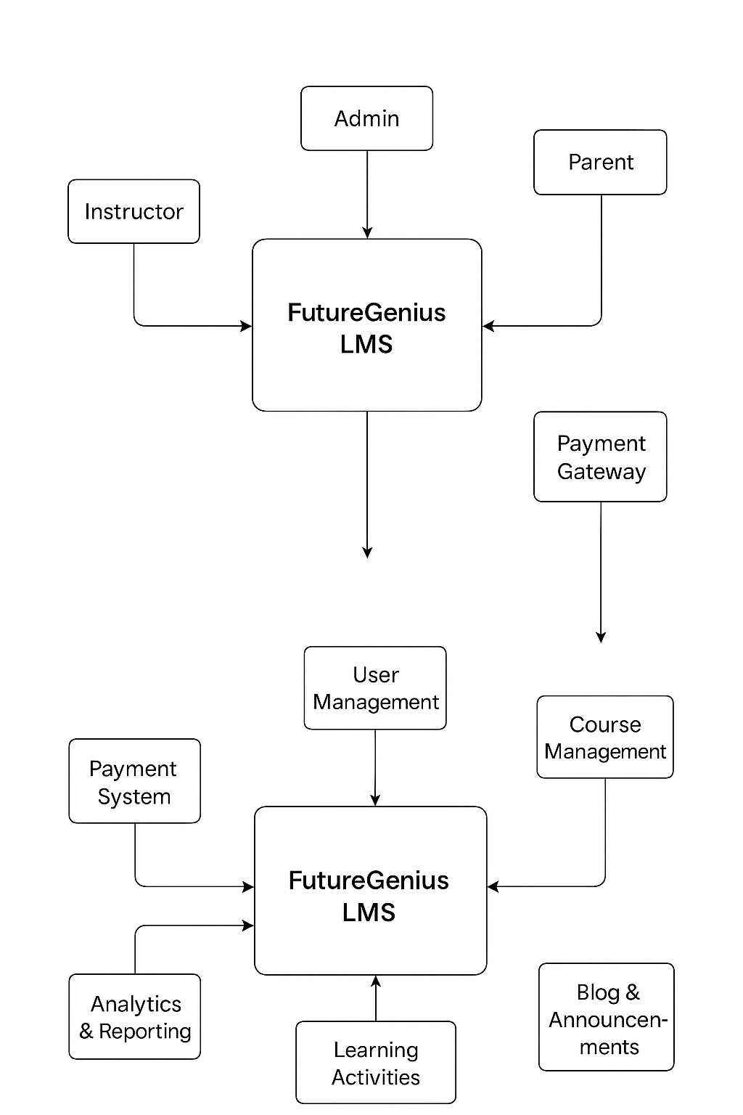
Process Model Diagram

Slide 4
Use Case Diagram

Slide 5
Business Rules Catalog
The FutureGenius LMS operates under several important business rules to ensure proper system management and smooth functionality:
• Each user has a specific role: admin, instructor, student, or parent.
• Every registered email must be unique.
• Only instructors and admins can create or edit courses.
• Students can enroll only in active courses.
• Paid courses unlock after payment confirmation.
• Late assignment submissions are marked accordingly.
• Quizzes can be attempted once unless reset by instructor.
• Deactivated users cannot log in.
• Parents can view only their child’s progress.
• New courses require admin approval.
• File uploads must follow size limits.
• Students earn gamification points.
• Refunds allowed within seven days of enrollment.
• System must comply with data privacy rules.
• Student progress updates automatically.

Slide 6
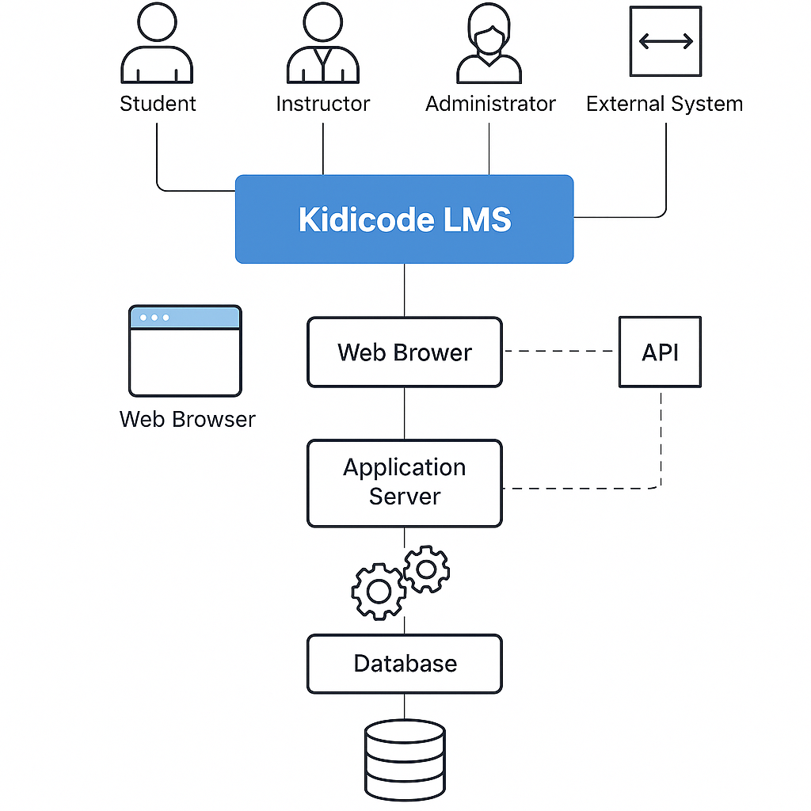
Architecture Design Diagram

Slide 7
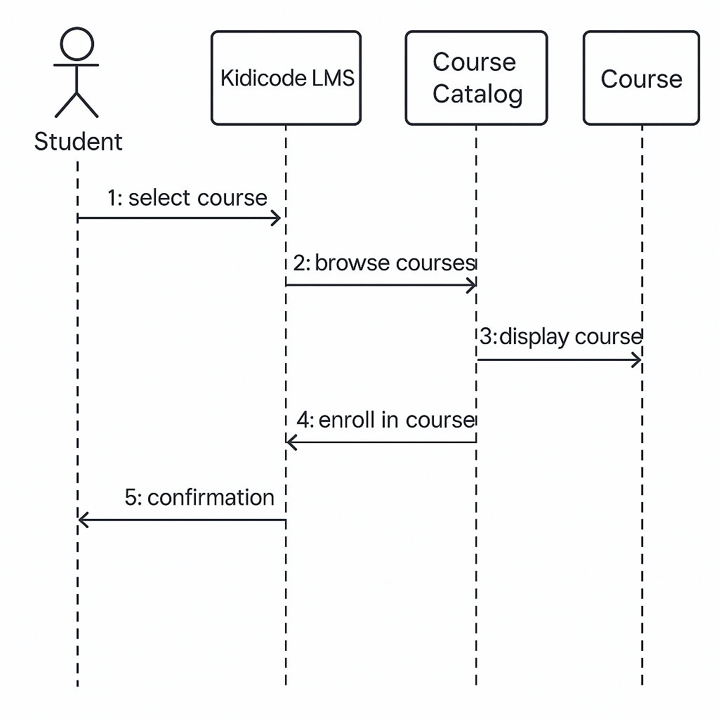
Sequence Diagrams

Slide 8
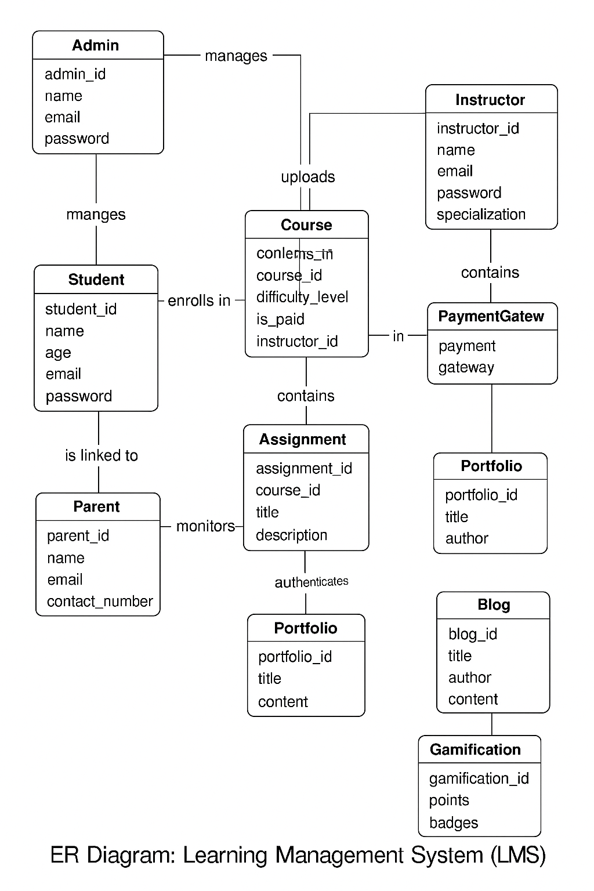
Entity Relationship Diagram (ERD)

Slide 9
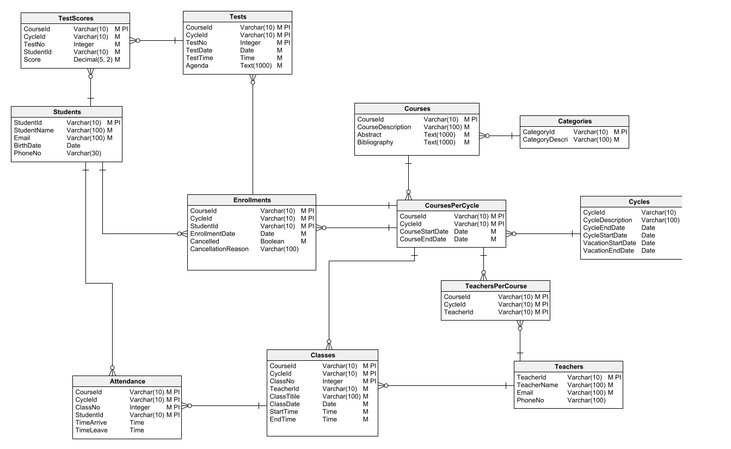
Database Design

Slide 10
Tools Used
• HTML, CSS
• PHP (Laravel Framework)
• Laravel Blade Templates
• JavaScript
• MySQL Database

Slide 11
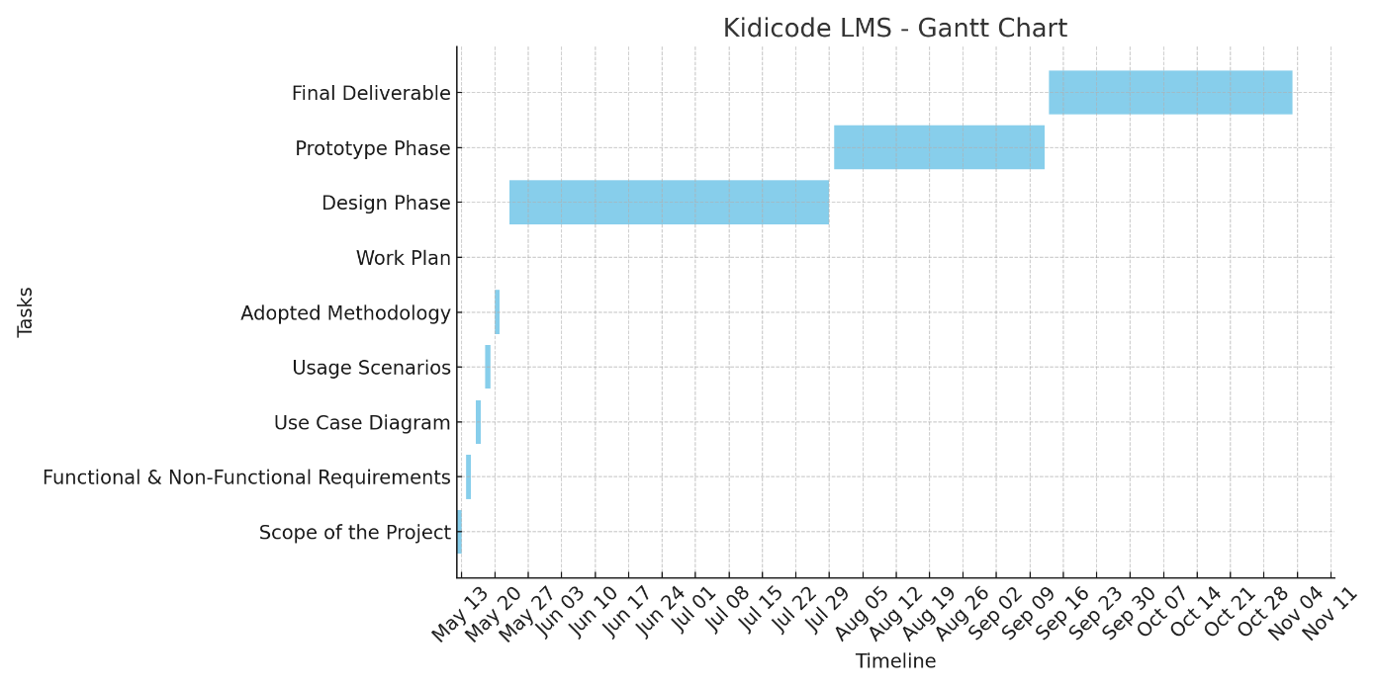
Gantt Chart

